Slide 1
Internal Progress update
Andrew Goode
Path Planning Subsystem

Slide 2
Areas of Struggle
Installing Ubuntu
Learning TurtleBot System

Slide 3
Areas of Success
Successfully Installing Ubuntu
Baseline Code Structure
Plan for Future Development

Slide 4
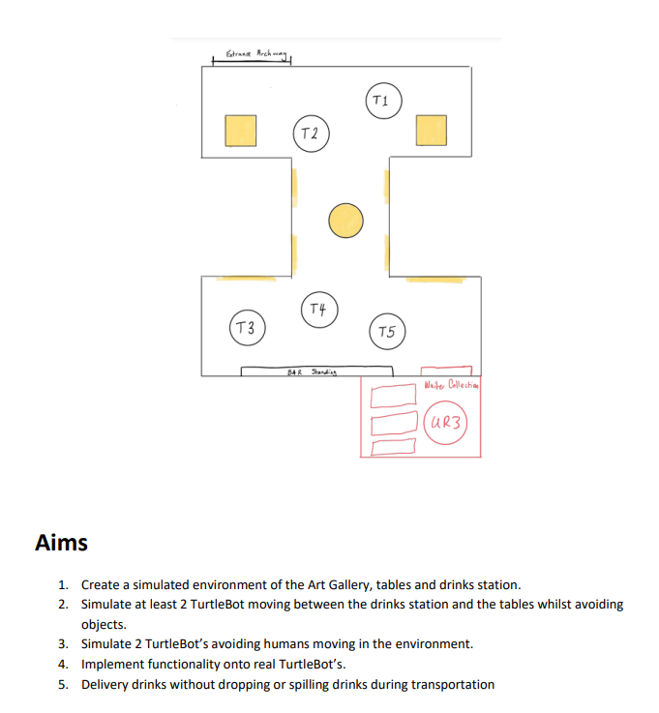
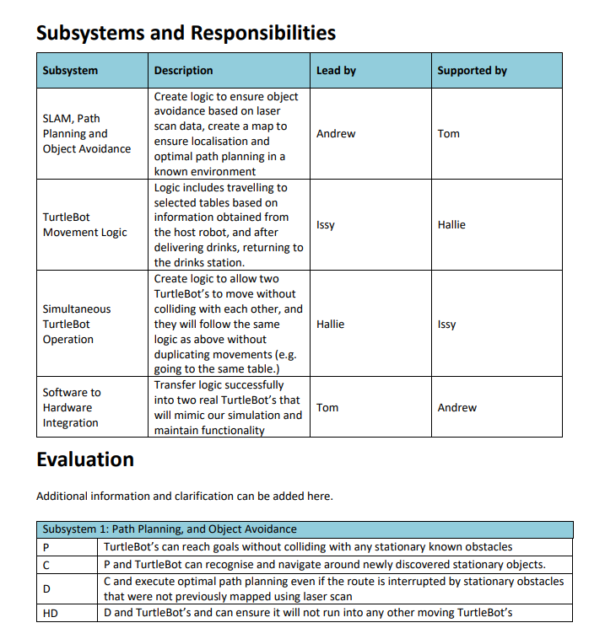
Group Charter

Slide 5
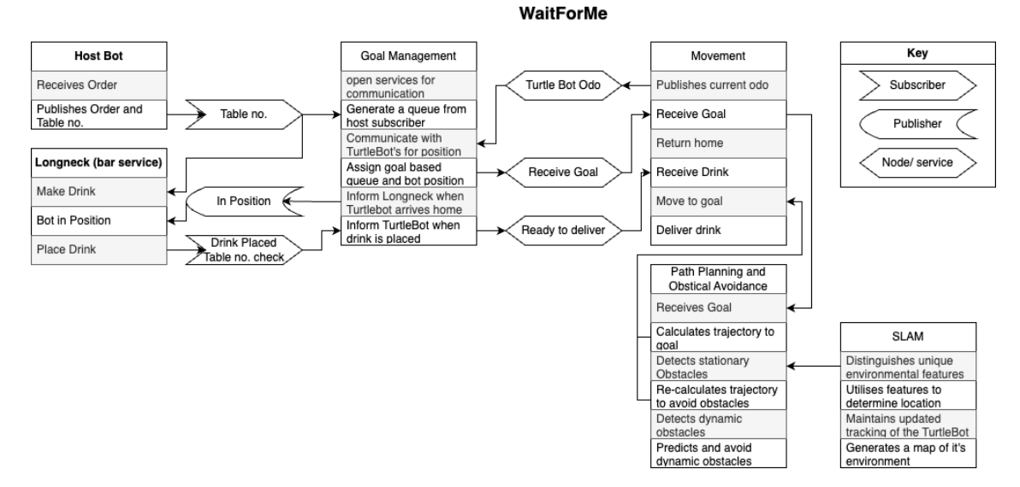
System Architecture

Slide 6


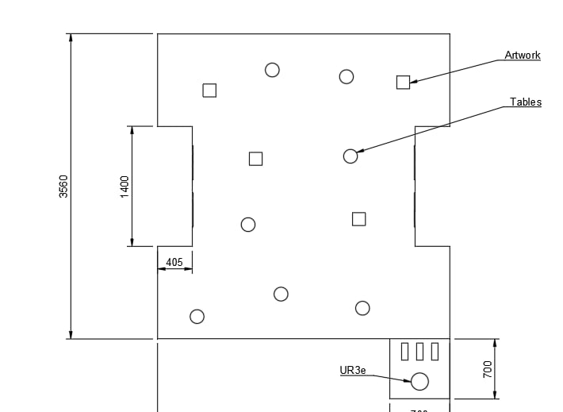

World Map
To Scale
Gazebo World to be Built by Other Group

Slide 7
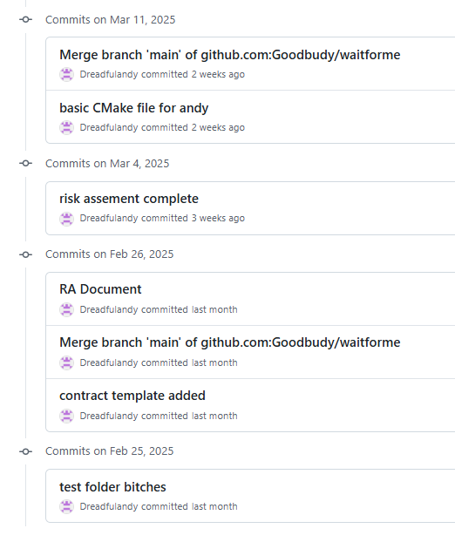
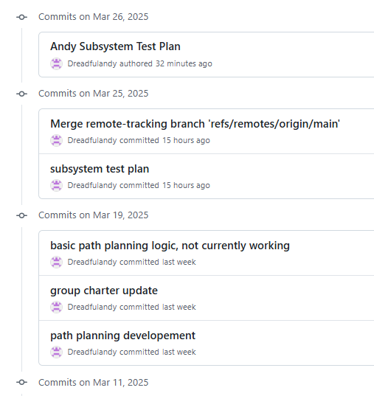
GitHub Commits

Slide 8
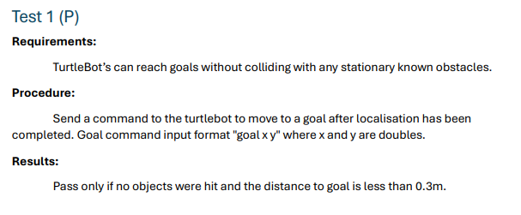
Test Plan

Slide 9
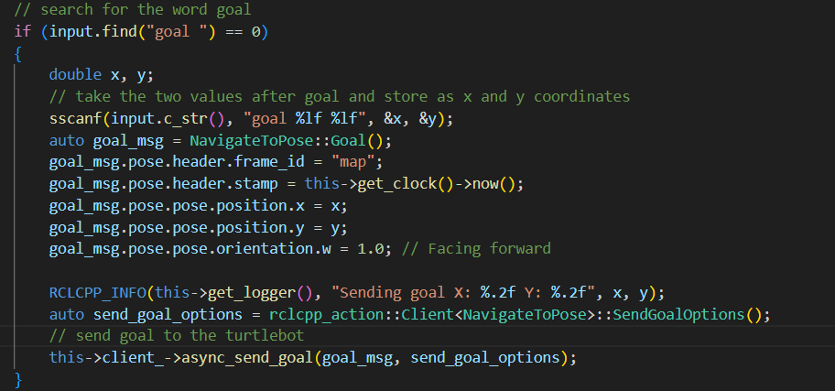
Current Working Code

